Slide 1
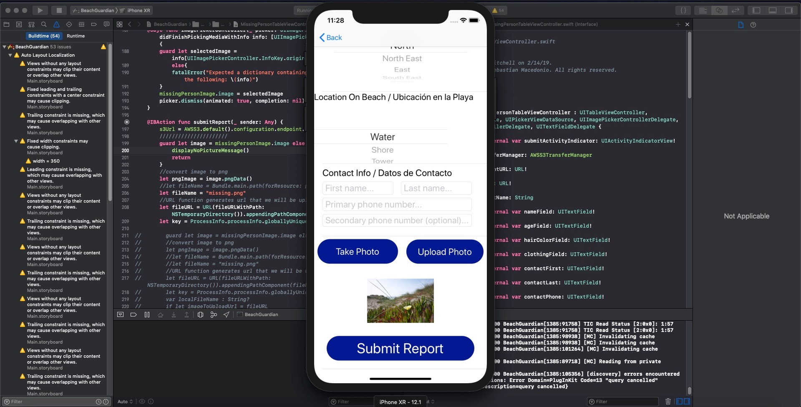
Edward – Week 4 (1)
This past week consisted of cleaning up S3 code, fixing bugs, and improving S3-related UI.
For the most part, using black box testing. Found that UI testing does not recognize the image picker. Will have to find some other way to test.

Slide 2
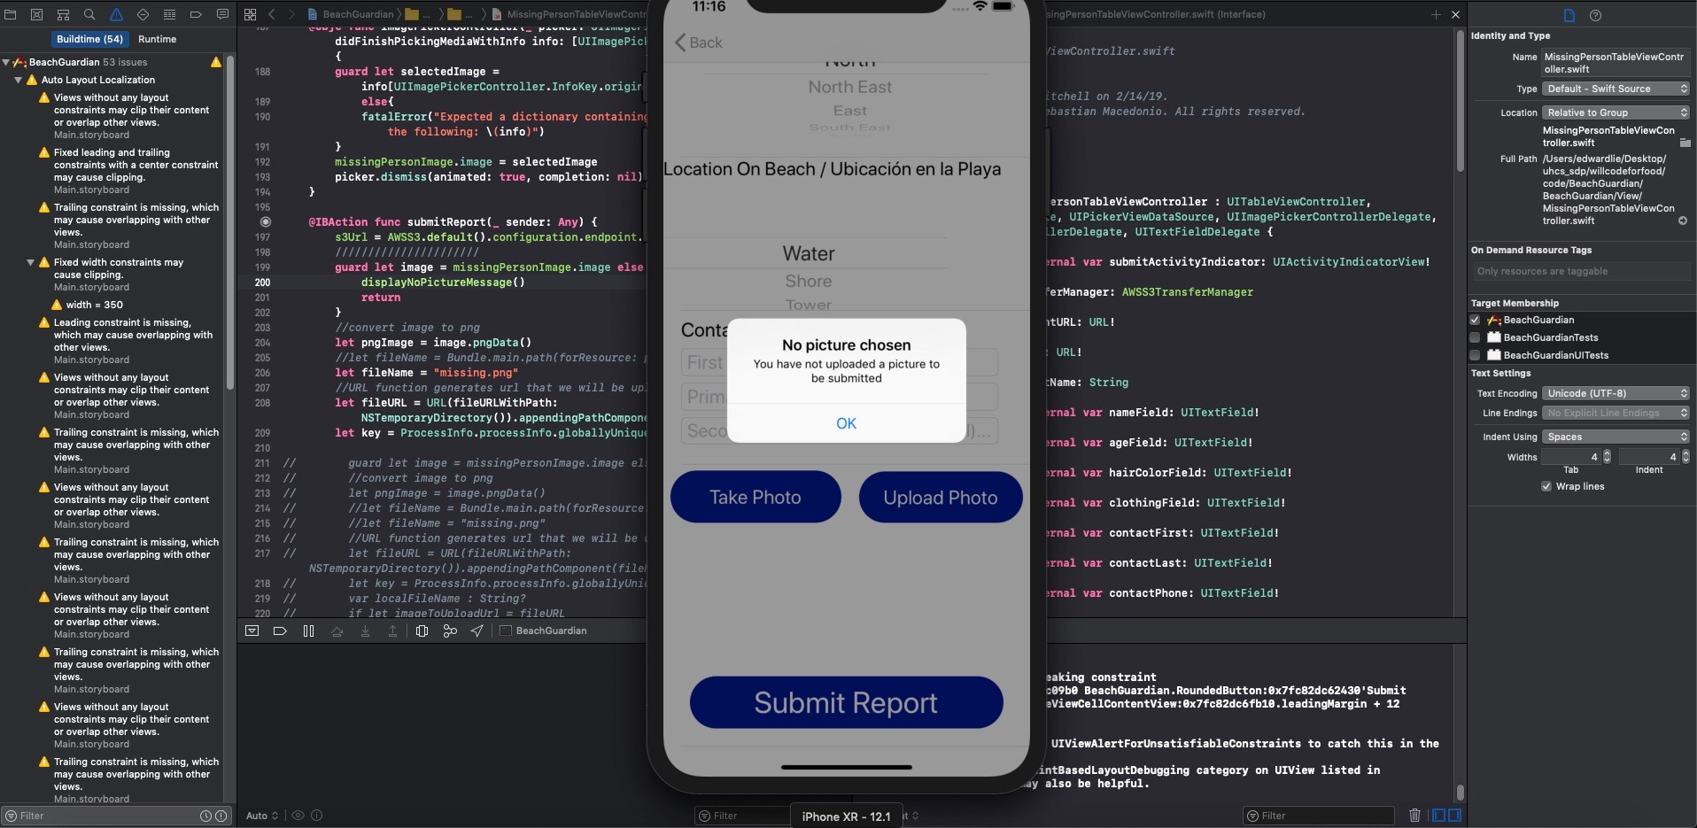
Edward – Week 4 (2)
Error catching added for submit button.
Photo View Controller updated to show camera roll instead of photo library.
My week 5 goal is to figure out how to get segues to work from photo icon.

